Slide 1
Show and Tell
Python Interpreter Revision Check
Write something here...
with open('here', 'w') as f: f.write('something')
A hampug presentation
2015 May 11
Ian Stewart
https://github.com/HamPUG

Slide 2
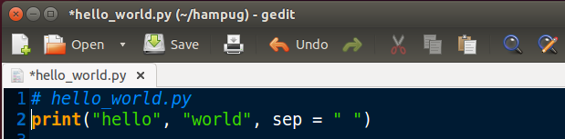
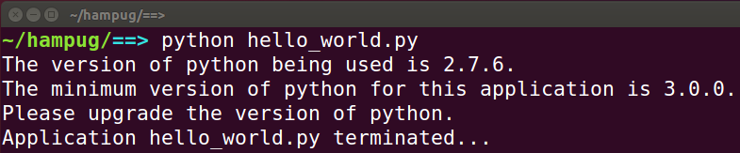
Python Interpreter Revision Check
The First Law of Interpreters...
The code most contemplated in any scripting language is that which prohibits further execution with an obsolete version of the interpreter.

Slide 3
Python Interpreter Revision Check
The Challenge...
Efficient code. Minimum number of lines of code.
Polite and informative error / exit message.
Say, “Please”
Provide application name
Provide current version
Provide Minimum version
Only one constant to define the minimum revision in an accepted style. E.g. PYTHON_VERSION_MINIMUM = '3.0.0'
No colons or semi-colons to join lines. Beautiful is better than ugly!
Code will execute OK with future revision releases.

Slide 4
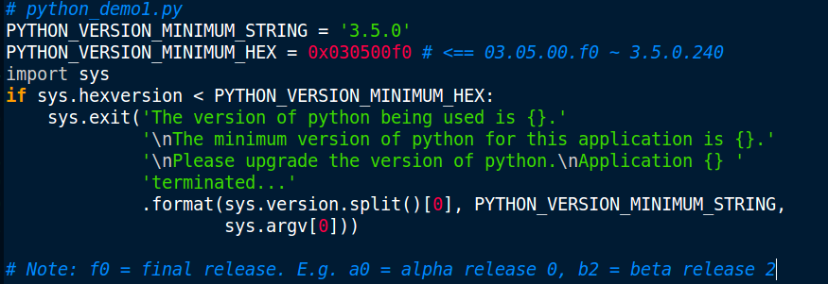
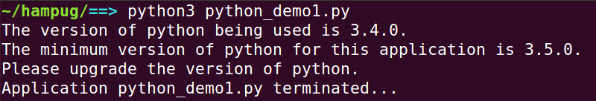
Demo1: 5 x lines of python, ...but 2 x constants
1
2
3
4
5
sys.hexversion = 50594032
hex(sys.hexverson) = '0x30400f0' = 03.04.00.f0 ~ 3.4.0

Slide 5
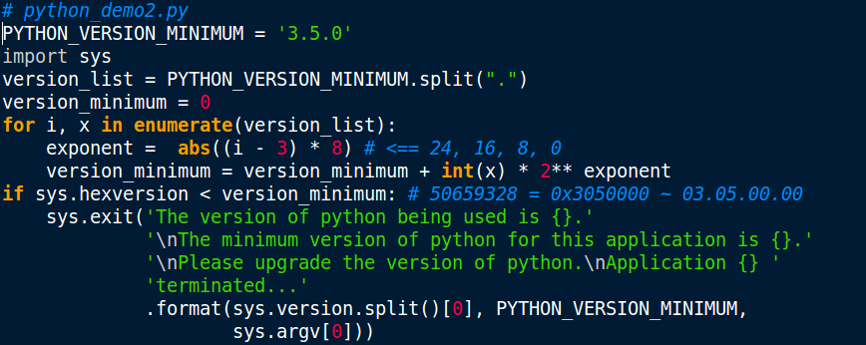
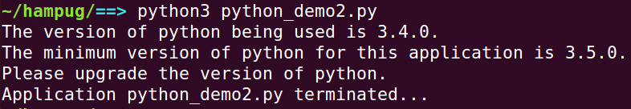
Demo2: 9 lines of python
1
2
3
4
5
6
7
8
9

Slide 6
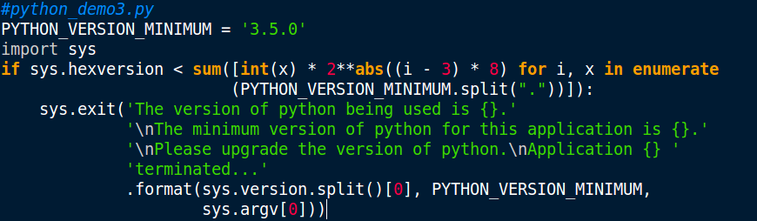
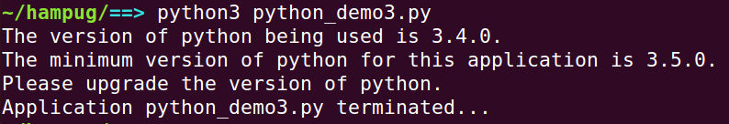
Demo3: 4 lines of python using List Comprehensions
Description of the list comprehension line of code... split('.') converts the '3.5.0' to a list ['3', '5', '0'] enumerate is for generating the exponents. 2²⁴, 2¹⁶, 2⁸, 2⁰ int(x) converts the string from the list to an integer sum([ … ]) accumulates the calculated values for each item in the list
1
2
3
4

Slide 7
new_list = [expression(x) for x in old_list if filter(x)]
List comprehensions consists of brackets containing an expression followed by a for clause, then zero or more for or if clauses. The expressions can be anything, meaning you can put in all kinds of objects in lists.
The result will be a new list resulting from evaluating the expression in the context of the for and if clauses which follow it.
The list comprehension always returns a result list.
List comprehension is a complete substitute for the lambda function as well as the functions map(), filter() and reduce().
References / examples / further reading...
https://docs.python.org/3/tutorial/datastructures.html#list-comprehensions
http://www.pythonforbeginners.com/basics/list-comprehensions-in-python
http://www.python-course.eu/list_comprehension.php
http://tech.pro/tutorial/1554/four-tricks-for-comprehensions-in-python

Slide 8
Revision Check:
Can it be done in less lines of code?...

Slide 9
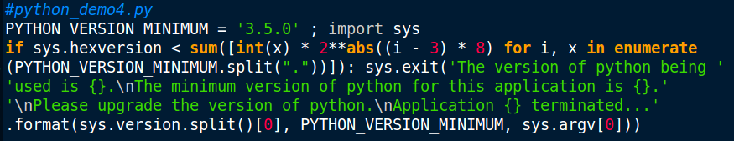
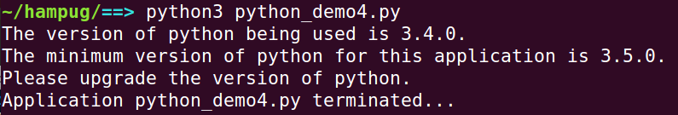
Demo4: 2 lines ...but cheating and using ; and :
...candidate for the violation of the Zen of Python award...
1
2

Slide 10
The Zen of Python
Beautiful is better than ugly.
Explicit is better than implicit.
Simple is better than complex.
Complex is better than complicated.
Flat is better than nested.
Sparse is better than dense.
Readability counts.
Special cases aren't special enough to break the rules.
Although practicality beats purity.
Errors should never pass silently.
Unless explicitly silenced.
In the face of ambiguity, refuse the temptation to guess.
There should be one-- and preferably only one --obvious way to do it...

Slide 11
__end__

